Slide 1
Carnegie Mellon Univ. Dept. of Computer Science 15-415/615 - DB Applications
C. Faloutsos – A. Pavlo
Lecture#24: Distributed Database Systems
(R&G ch. 22)

Slide 2
Administrivia
HW7 Phase 1: Wed Nov 9th
HW7 Phase 2: Mon Nov 28th
HW8: Mon Dec 5th
Final Exam: Tue Dec 13th @ 5:30pm

Slide 3
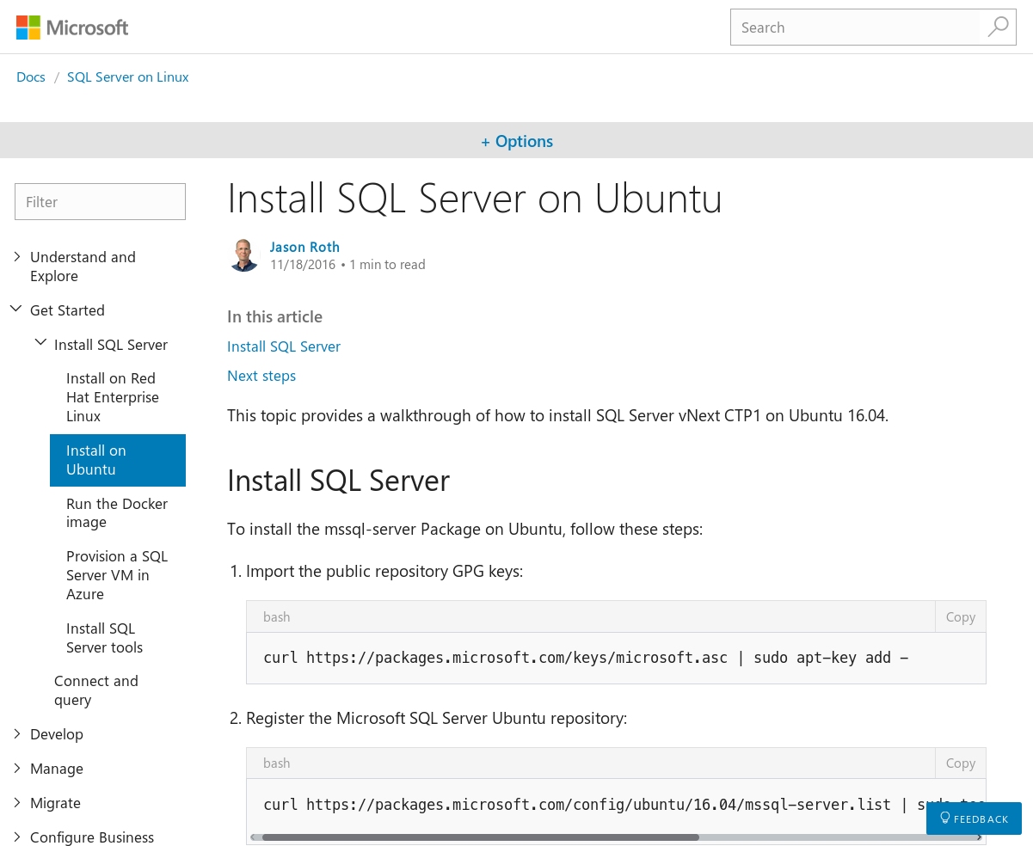
SQL Server on Linux
Microsoft has released first public binaries for SQL Server running for Linux.
This is awesome.

Slide 4
Today’s Class
High-level overview of distributed DBMSs.
Not meant to be a detailed examination of all aspects of these systems.

Slide 5
Today’s Class
Overview & Background
Design Issues
Distributed OLTP
Distributed OLAP

Slide 6
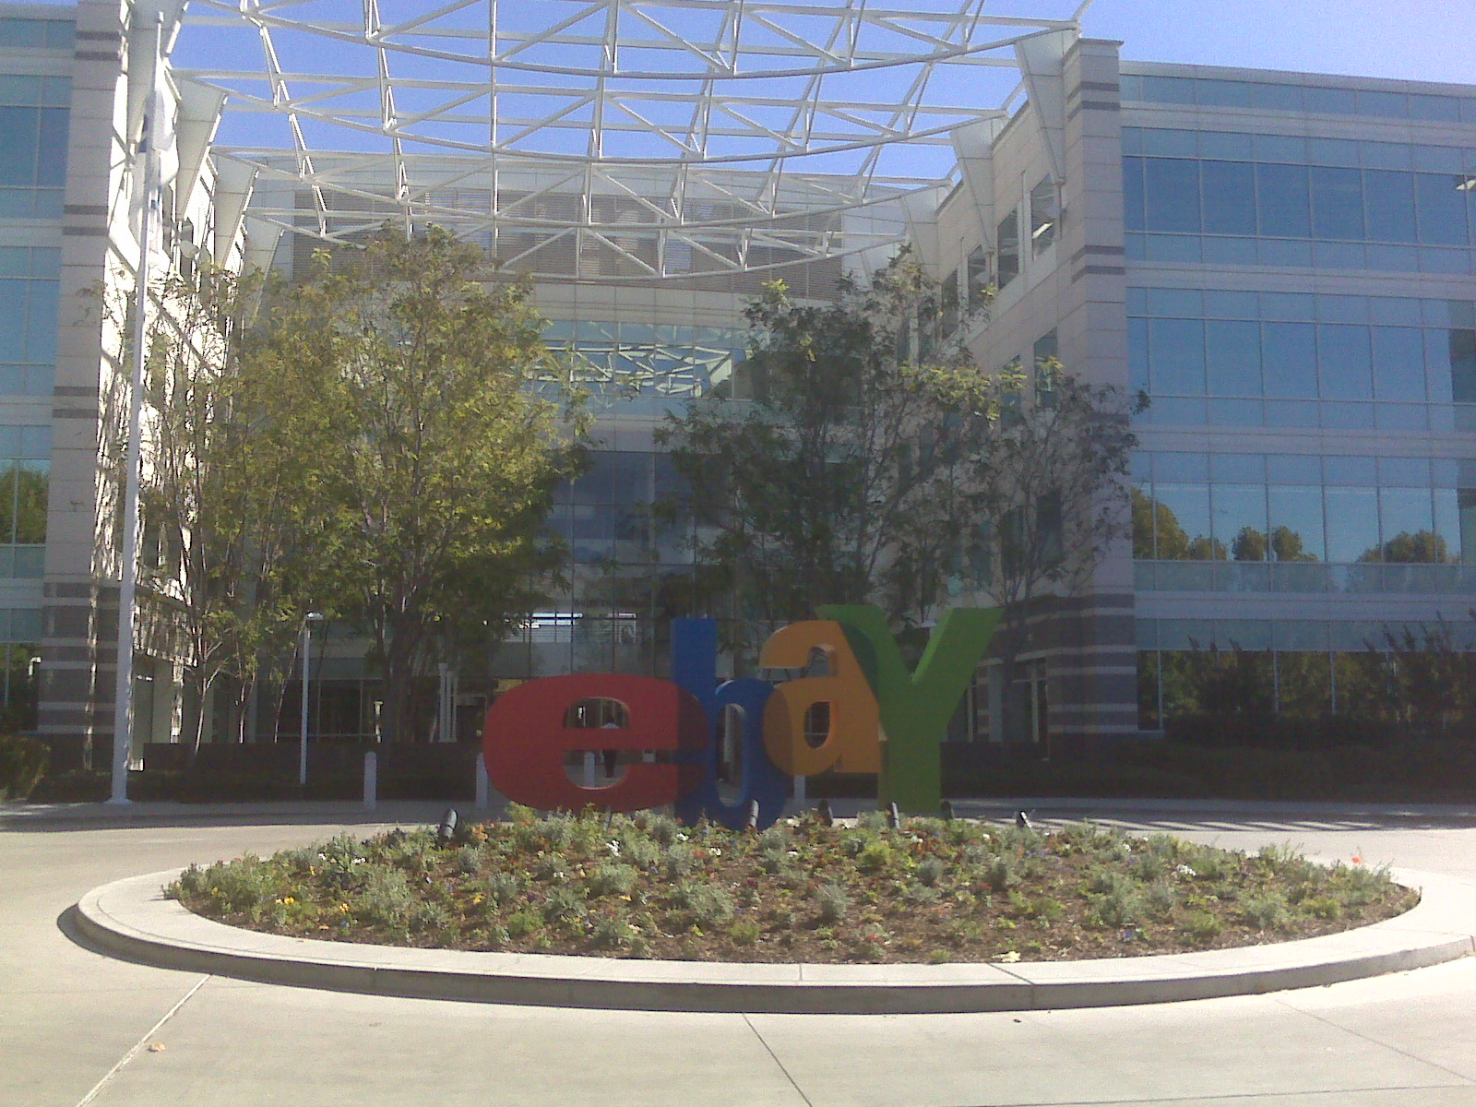
Why Do We Need Parallel/Distributed DBMSs?
PayPal in 2009…
Single, monolithic Oracle installation.
Had to manually move data every xmas.
Legal restrictions.

Slide 7
Why Do We Need Parallel/Distributed DBMSs?
Increased Performance.
Increased Availability.
Potentially Lower TCO.

Slide 8
Parallel/Distributed DBMS
Database is spread out across multiple resources to improve parallelism.
Appears as a single database instance to the application.
SQL query for a single-node DBMS should generate same result on a parallel or distributed DBMS.

Slide 9
Parallel vs. Distributed
Parallel DBMSs:
Nodes are physically close to each other.
Nodes connected with high-speed LAN.
Communication cost is assumed to be small.
Distributed DBMSs:
Nodes can be far from each other.
Nodes connected using public network.
Communication cost and problems cannot be ignored.

Slide 10
Database Architectures
The goal is parallelize operations across multiple resources.
CPU
Memory
Network
Disk

Slide 11


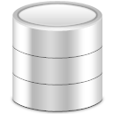
Database Architectures
Network
Network
Network
Shared
Memory
Shared
Disk
Shared
Nothing

Slide 12
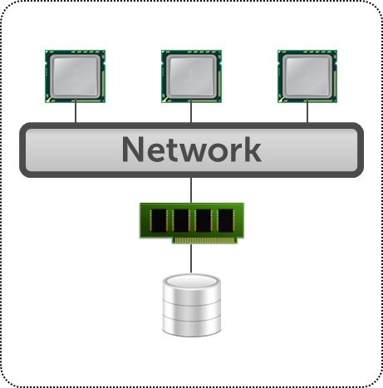
Shared Memory
CPUs and disks have access to common memory via a fast interconnect.
Very efficient to send messages between processors.
Sometimes called “shared everything”
Examples: All single-node DBMSs.

Slide 13
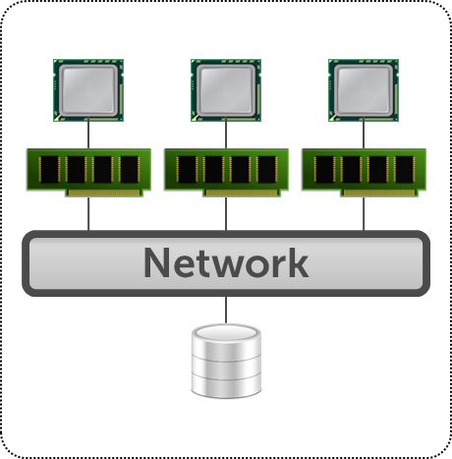
Shared Disk
All CPUs can access all disks directly via an interconnect but each have their own private memories.
Easy fault tolerance.
Easy consistency since there is a single copy of DB.
Examples: Oracle Exadata, ScaleDB.

Slide 14
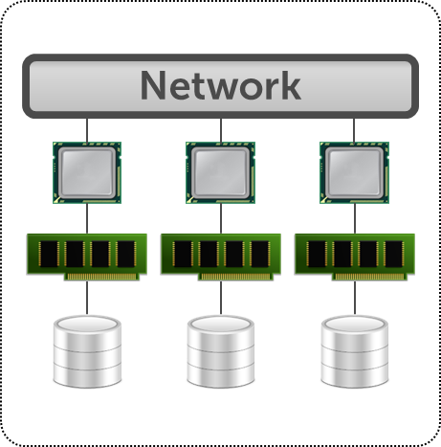
Shared Nothing
Each DBMS instance has its own CPU, memory, and disk.
Nodes only communicate with each other via network.
Easy to increase capacity.
Hard to ensure consistency.
Examples: Vertica, Parallel DB2, MongoDB.

Slide 15
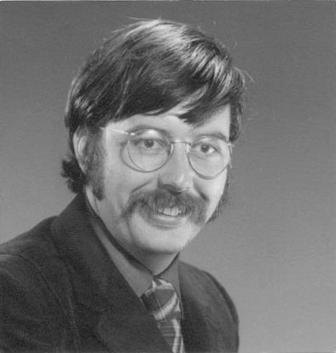



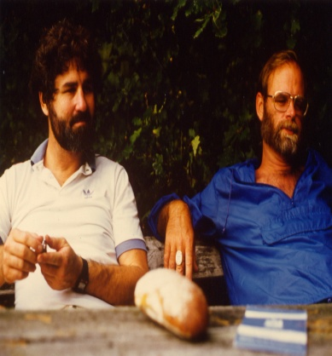
Early Systems
MUFFIN – UC Berkeley (1979)
SDD-1 – CCA (1980)
System R* – IBM Research (1984)
Gamma – Univ. of Wisconsin (1986)
NonStop SQL – Tandem (1987)
Stonebraker
Bernstein
Mohan
DeWitt
Gray

Slide 16
Inter- vs. Intra-query Parallelism
Inter-Query: Different queries or txns are executed concurrently.
Increases throughput & reduces latency.
Already discussed for shared-memory DBMSs.
Intra-Query: Execute the operations of a single query in parallel.
Decreases latency for long-running queries.

Slide 17
Parallel/Distributed DBMSs
Advantages:
Data sharing.
Reliability and availability.
Speed up of query processing.
Disadvantages:
May increase processing overhead.
Harder to ensure ACID guarantees.
More database design issues.

Slide 18
Today’s Class
Overview & Background
Design Issues
Distributed OLTP
Distributed OLAP

Slide 19
Design Issues
How do we store data across nodes?
How does the application find data?
How to execute queries on distributed data?
Push query to data.
Pull data to query.
How does the DBMS ensure correctness?

Slide 20
Database Partitioning
Split database across multiple resources:
Disks, nodes, processors.
Sometimes called “sharding”
The DBMS executes query fragments on each partition and then combines the results to produce a single answer.

Slide 21
Naïve Table Partitioning
Each node stores one and only table.
Assumes that each node has enough storage space for a table.

Slide 22
Naïve Table Partitioning
Partitions
Table1
Table2
Tuple1
Table1
Tuple2
Tuple3
Tuple4
Tuple5
Table2
Ideal Query:
SELECT * FROM table

Slide 23
Horizontal Partitioning
Split a table’s tuples into disjoint subsets.
Choose column(s) that divides the database equally in terms of size, load, or usage.
Each tuple contains all of its columns.
Three main approaches:
Round-robin Partitioning.
Hash Partitioning.
Range Partitioning.

Slide 24
Horizontal Partitioning
Table
Partitions
Partitioning Key
Tuple1
P1
P2
Tuple2
Tuple3
Tuple4
P3
P4
Tuple5
Ideal Query:
P5
SELECT * FROM table
WHERE partitionKey = ?

Slide 25
Vertical Partitioning
Split the columns of tuples into fragments:
Each fragment contains all of the tuples’ values for column(s).
Use fixed length attribute values to ensure that the original tuple can be reconstructed.
Column fragments can also be horizontally partitioned.

Slide 26
Vertical Partitioning
Table
Partitions
Tuple1
P1
P2
Tuple2
Tuple3
Tuple4
P3
P4
Tuple5
Ideal Query:
P5
SELECT column FROM table

Slide 27
Replication
Partition Replication: Store a copy of an entire partition in multiple locations.
Master – Slave Replication
Table Replication: Store an entire copy of a table in each partition.
Usually small, read-only tables.
The DBMS ensures that updates are propagated to all replicas in either case.

Slide 28
Replication
Partition Replication
Table Replication
P1
P1
Slave
P1
Table
Master
P1
Node 1
Slave
P2
P2
P2
Slave
Table
Master
P2
Node 2
Slave

Slide 29
Data Transparency
Users should not be required to know where data is physically located, how tables are partitioned or replicated.
A SQL query that works on a single-node DBMS should work the same on a distributed DBMS.

Slide 30
Today’s Class
Overview & Background
Design Issues
Distributed OLTP
Distributed OLAP

Slide 31
OLTP vs. OLAP
On-line Transaction Processing:
Short-lived txns.
Small footprint.
Repetitive operations.
On-line Analytical Processing:
Long running queries.
Complex joins.
Exploratory queries.

Slide 32
Distributed OLTP
Execute txns on a distributed DBMS.
Used for user-facing applications:
Example: Credit card processing.
Key Challenges:
Consistency
Availability

Slide 33
Single-Node vs. Distributed Transactions
Single-node txns do not require the DBMS to coordinate behavior between nodes.
Distributed txns are any txn that involves more than one node.
Requires expensive coordination.

Slide 34
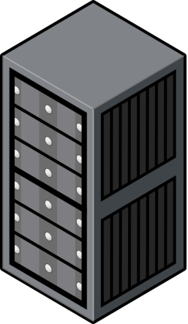
Simple Example
Commit
Execute Queries
Begin
Node 1
Application
Server
Node 2

Slide 35
Transaction Coordination
Assuming that our DBMS supports multi-operation txns, we need some way to coordinate their execution in the system.
Two different approaches:
Centralized: Global “traffic cop”.
Decentralized: Nodes organize themselves.

Slide 36
TP Monitors
Example of a centralized coordinator.
Originally developed in the 1970-80s to provide txns between terminals + mainframe databases.
Examples: ATMs, Airline Reservations.
Many DBMSs now support the same functionality internally.

Slide 37
Centralized Coordinator
Safe to commit?
Commit Request
Coordinator
Partitions
Lock Request
Acknowledgement
P1
P2
Repl
Repl
P3
P4
Repl
Repl
Application
Server
P5
Repl

Slide 38
Centralized Coordinator
Partitions
Query Requests
P1
P2
Middleware
Safe to commit?
Repl
Repl
P3
P4
Repl
Repl
Application
Server
P5
Repl

Slide 39
Decentralized Coordinator
Commit Request
Partitions
Safe to commit?
P1
P2
Repl
Repl
P3
P4
Repl
Repl
Application
Server
P5
Repl

Slide 40
Observation
Q: How do we ensure that all nodes agree to commit a txn?
What happens if a node fails?
What happens if our messages show up late?

Slide 41

CAP Theorem
Proposed by Eric Brewer that it is impossible for a distributed system to always be:
Consistent
Always Available
Network Partition Tolerant
Proved in 2002.
Pick Two!
Brewer

Slide 42




CAP Theorem
All up nodes can satisfy all requests.
Linearizability
C
A
Consistency
Availability
Partition Tolerant
No Man’s Land
P
Still operate correctly despite message loss.

Slide 43
CAP – Consistency
Must see both changes or no changes
Set A=2, B=9
Read A,B
A=2
B=9
Application
Server
Application
Server
Master
Replica
A=1
NETWORK
A=2
A=1
A=2
B=8
B=9
B=8
B=9
Node 1
Node 2

Slide 44
CAP – Availability
Read B
Read A
B=8
A=1
Application
Server
Application
Server
X
A=1
NETWORK
A=1
B=8
B=8
Node 1
Node 2

Slide 45
CAP – Partition Tolerance
Set A=2, B=9
Set A=3, B=6
Application
Server
Application
Server
Master
X
Master
A=1
NETWORK
A=2
A=1
A=3
B=8
B=9
B=8
B=6
Node 1
Node 2

Slide 46
CAP Theorem
These are essentially the same!
Relational DBMSs: CA/CP
Examples: IBM DB2, MySQL Cluster, VoltDB
NoSQL DBMSs: AP
Examples: Cassandra, Riak, DynamoDB

Slide 47
Atomic Commit Protocol
When a multi-node txn finishes, the DBMS needs to ask all of the nodes involved whether it is safe to commit.
All nodes must agree on the outcome
Examples:
Two-Phase Commit
Three-Phase Commit (not used)
Paxos

Slide 48
Two-Phase Commit
Commit Request
OK
Participant
OK
Application
Server
Phase1: Prepare
Node 2
OK
Phase2: Commit
Coordinator
Participant
OK
Node 1
Node 3

Slide 49
Two-Phase Commit
Commit Request
OK
Application
Server
Phase1: Prepare
Node 2
ABORT
Phase2: Abort
OK
Node 1
Node 3

Slide 50
Two-Phase Commit
Each node has to record the outcome of each phase in a stable storage log.
Q: What happens if coordinator crashes?
Participants have to decide what to do.
Q: What happens if participant crashes?
Coordinator assumes that it responded with an abort if it hasn’t sent an acknowledgement yet.
The nodes have to block until they can figure out the correct action to take.

Slide 51
Paxos
Consensus protocol where a coordinator proposes an outcome (e.g., commit or abort) and then the participants vote on whether that outcome should succeed.
Does not block if a majority of participants are available and has provably minimal message delays in the best case.

Slide 52
2PC vs. Paxos
Two-Phase Commit: blocks if coordinator fails after the prepare message is sent, until coordinator recovers.
Paxos: non-blocking as long as a majority participants are alive, provided there is a sufficiently long period without further failures.

Slide 53
Distributed Concurrency Control
Need to allow multiple txns to execute simultaneously across multiple nodes.
Many of the same protocols from single-node DBMSs can be adapted.
This is harder because of:
Replication.
Network Communication Overhead.
Node Failures.

Slide 54

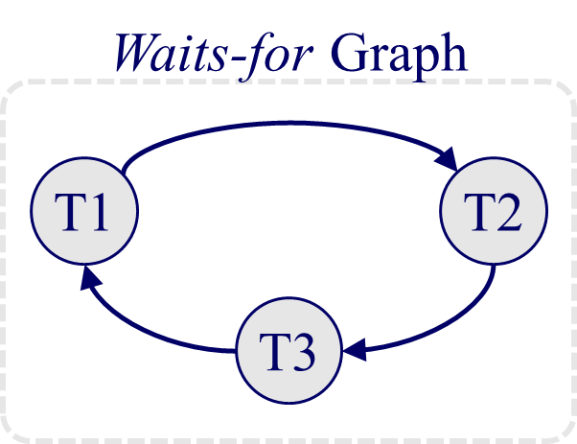
Distributed 2PL
Set A=2, B=9
Set A=0, B=7
Application
Server
Application
Server
NETWORK
A=1
B=8
Node 1
Node 2

Slide 55
Recovery
Q: What do we do if a node crashes in CA/CP DBMS?
If node is replicated, use Paxos to elect a new primary.
If node is last replica, halt the DBMS.
Node can recover from checkpoints + logs and then catch up with primary.

Slide 56
Today’s Class
Overview & Background
Design Issues
Distributed OLTP
Distributed OLAP

Slide 57
Distributed OLAP
Execute analytical queries that examine large portions of the database.
Used for back-end data warehouses:
Example: Data mining
Key Challenges:
Data movement.
Query planning.

Slide 58
Distributed OLAP
Single Complex
Query
Partitions
P1
P2
Repl
Repl
P3
P4
Repl
Repl
Application
Server
P5
Repl

Slide 59
Distributed Joins Are Hard
SELECT * FROM table1, table2
WHERE table1.val = table2.val
Assume tables are horizontally partitioned:
Table1 Partition Key → table1.key
Table2 Partition Key → table2.key
Q: How to execute?
Naïve solution is to send all partitions to a single node and compute join.

Slide 60
Semi-Joins
Main Idea: First distribute the join attributes between nodes and then recreate the full tuples in the final output.
Send just enough data from each table to compute which rows to include in output.
Lots of choices make this problem hard:
What to materialize?
Which table to send?

Slide 61
Summary
Everything is harder in a distributed setting:
Concurrency Control
Query Execution
Recovery

Slide 62
Rest of the Semester
Mon Nov 28th – Column Stores
Wed Nov 30th – Data Warehousing + Mining
Mon Dec 5th – SpliceMachine Guest Speaker
Wed Dec 7th –Review + Systems Potpourri
http://cmudb.io/f16-systems

Slide 63

















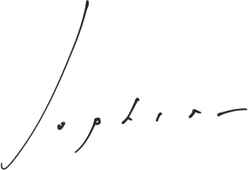













































Systems Potpourri

Slide 64
System Votes (Fall 2015)
MongoDB | 32
Google Spanner/F1 | 22
LinkedIn Espresso | 16
Apache Cassandra | 16
Facebook Scuba | 16
Apache Hbase | 14
VoltDB | 10
Redis | 10
Vertica | 5
Cloudera Impala | 5
DeepDB | 2
SAP HANA | 1
CockroachDB | 1
SciDB | 1
InfluxDB | 1
Accumulo | 1
Apache Trafodion | 1

